Slide 1
DrainHive
The Autonomous Drainage Cleaning Robot

Slide 2
Objectives
The objective of this project is to develop an autonomous robotic system for efficient drainage cleaning and real-time monitoring.
The robot will utilize AI-driven navigation, sensors, and cleaning mechanisms to detect and remove blockages while providing remote feedback.
This system aims to enhance urban wastewater management by reducing manual labor, improving efficiency, and preventing drainage failures.

Slide 3
Methodology
The project begins to analyze drainage systems and identify key challenges. The robot's design incorporates durable materials, autonomous navigation (LiDAR, AI-based SLAM), and advanced cleaning mechanisms like high-pressure jets and augers.
A real-time monitoring system with cloud connectivity ensures remote tracking, alerts, and diagnostics.
The system undergoes controlled environment testing to refine navigation, cleaning efficiency, and obstacle handling.
Finally, field trials and optimization ensure full functionality before deployment in real-world drainage systems.

Slide 4
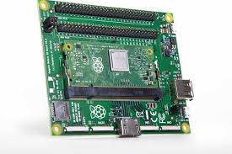
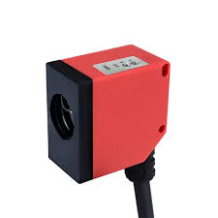
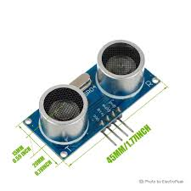
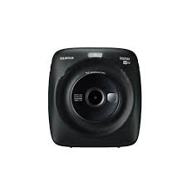
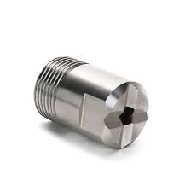
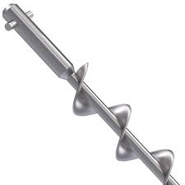
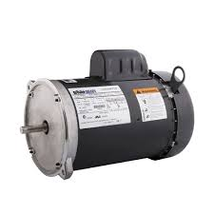
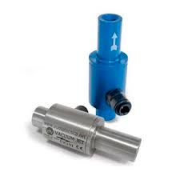



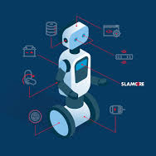


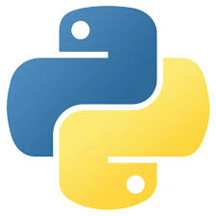
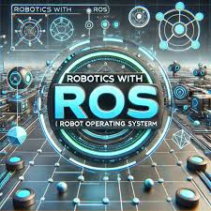

WORK FLOW
Rasperry pi
LIDAR
Ultrasonics
Camera
Water jets
Augers
Motors
Actuators
Raspberry Pi
LIDAR
Ultrasonics
Camera
Water Jets
Augers
Auger
Motor
Actuators
Google Cloud
IoT
MQTT
SLAM Algo.
OpenCV
TensorFlow
Python
ROS
Google Cloud
IoT
MQTT
SLAM
Algorithm
OpenCV
TensorFlow
Python
ROS
Flask
MQTT
Flask
MQTT

Slide 5
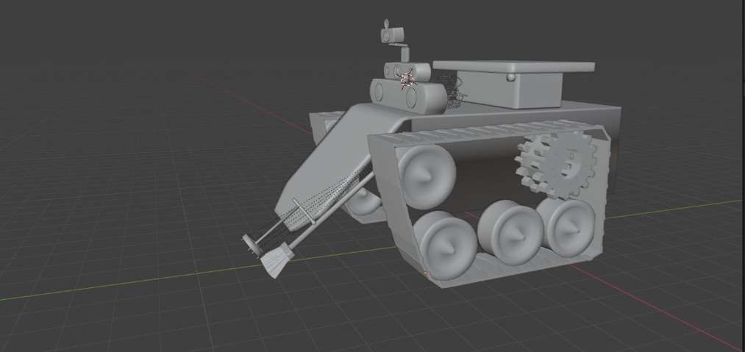
3D MODEL

